Slide 1
University of Central Florida
Contractors Fair
Jon Varnell, Vice President of Administrative Operations
Ben Davis, Assistant Vice President for Planning, Design, & Construction
Duane Siemen, Assistant Vice President for Utilities & Engineering Services
John McInerney, Director Facilities Maintenance Samantha Mason, Construction Support Team Manager

Slide 2
Agenda
FBO Leadership Team
UCF Overview
Planning, Design & Construction
Utilities & Engineering Services
Facilities Operations
Pathways for Partnership with UCF
Meet & Greet

Slide 3
FBO Leadership Team
Jon Varnell
Vice President of Administrative Operations
Danielle Sarris
Executive Assistant
Jon Bates
AVP, Real Estate &
Space Administration
Ben Davis
AVP, Planning, Design & Construction
Duane Siemen
AVP, Utilities & Engineering Services
Kevin Sowers
AVP, Business Operations
Justin Wisor
AVP, Facilities Operations
Donna DuBuc
Director, Budget
Doug Lewis
Director, Human Resources
Jennifer Elliott
Director, Arboretum & Sustainability Initiatives
Michelle Laxer
Communications Manager
University of Central Florida
Page 3

Slide 4
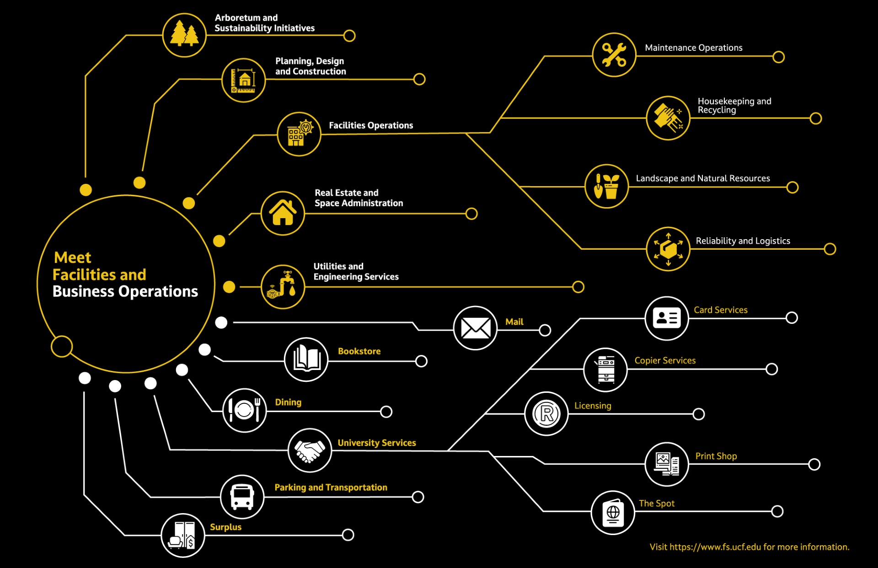
University of Central Florida
Page 5

Slide 5
69,320
Fall 2023 Enrollment
18,309 degrees awarded in 2023
University of Central Florida
Notes:
“one of the largest” universities
Offers 104 bachelor’s, 97 master’s, 33 research doctorates, 3 professional doctorates and 3 specialist degree programs
419,318 degrees conferred as of Aug 2023
5

Slide 6
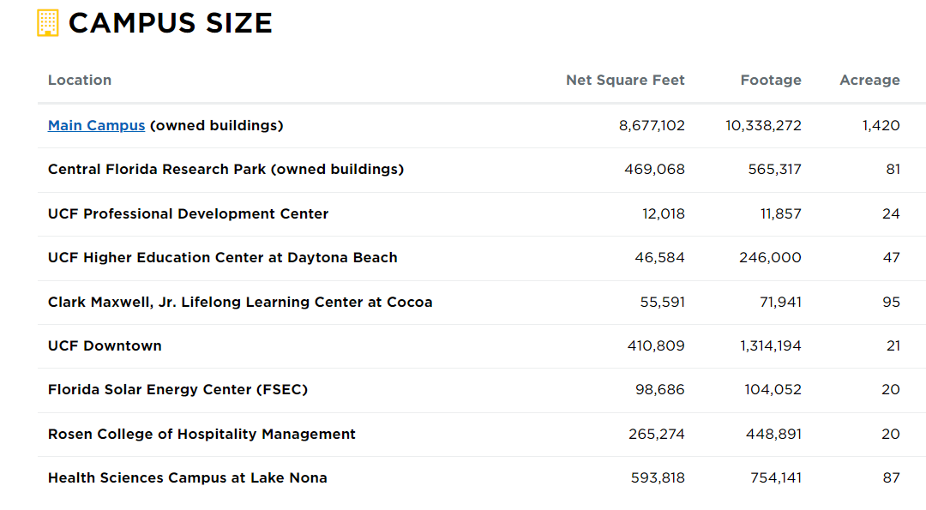
Total SF 10.6M NSF 13.8M GSF 1,815 ACRES
University of Central Florida
Page 4

Slide 7
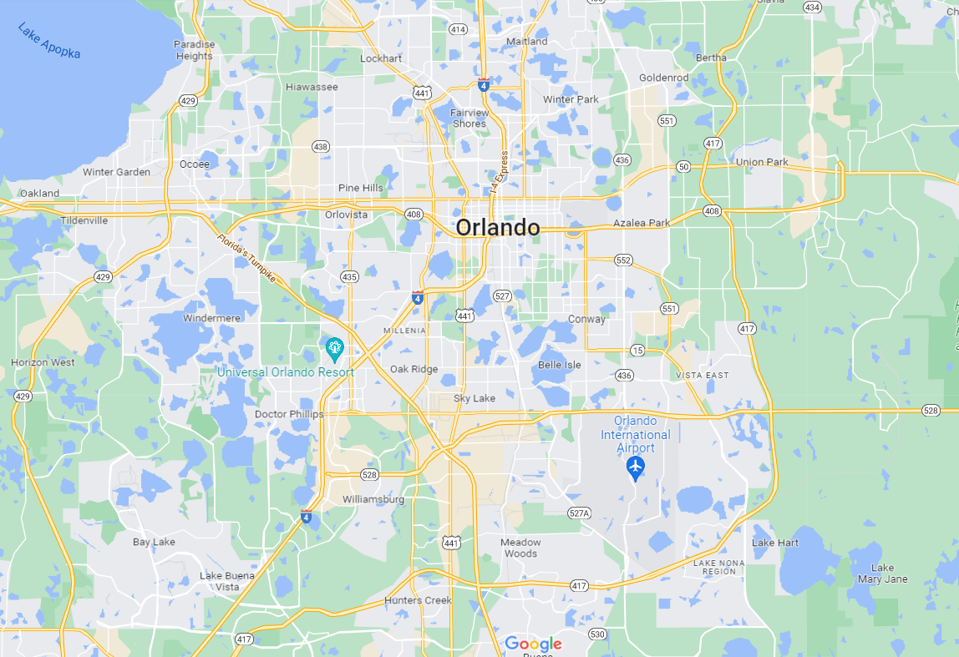
MAIN
CAMPUS
UCF
DOWNTOWN
ROSEN COLLEGE
OF HOSPITALITY
MANAGEMENT
HEALTH SCIENCES
CAMPUS
Notes:
Four campuses – Main in east Orlando, Health Sciences in Lake Nona, Rosen in entertainment area, UCF Downtown

Slide 8
Planning, Design & Construction
Ben Davis, Assistant Vice President

Slide 9
Ben Davis
Assistant Vice President
Planning, Design and Construction
PDC Team
Dora Summa
Executive Assistant
Bill Martin
University Architect
Tom Anguish
Project Portfolio Manager
Jay Malcolm
Project Portfolio Manager
Walter Gordon
Project Portfolio Manager
Dan Reid
Project Portfolio Manager
Samantha Mason
Construction Support Team Manager
Susan Hutson
Senior Campus Planner
David Edgar
Senior Project Manager
Alice Arguelles
Senior Project Manager
George Hayner Jr.
Senior Project Manager
Vacant
Senior Project Manager
John Settle
Project Coordinator
Vacant
Campus Planner II
Robert Sharps
Project Manager
Joanne Toole
Project Manager
Paul Weatherly
Senior Project Manager
Greg Minenna
Project Manager
Gina Seabrook
Project Coordinator
DJ Thomas
Assistant Project Manager
Christina Rogers
Assistant Project Manager
Scott Suto
Project Manager
Maria Teimouri
Assistant Project Manager
Matt Green
Technology Manager
Donna Palmisciano
Interior Designer
Vacant
Project Manager
Robert Brown
OAR
Vacant
Building Specialist
Jose Davila
OAR
Vacant
Construction Project Assistant
University of Central Florida
Notes:
=
9

Slide 10
Projects By Phase
As of January 1, 2024
Design
220
ACTIVE
PROJECTS
Permit
11%
11%
284
Current
Projects
Construction
Close-out
32
78%
Awaiting Customer
32
Temporary Hold
Current Projects Only
Total above does not include Completed or Cancelled Projects
COMPLETED – 82
7/1/23 to 1/1/24
University of Central Florida
Page 9

Slide 11
Projects By Type
Office / Classroom – 22%
As of January 1, 2024
MEP Systems / Utility – 20%
3%
2%
1%
Athletics – 9%
4%
Grounds / Infrastructure – 9%
6%
Research - 8%
22%
7%
284
Current
Projects
Capital Projects – 7%
8%
Life Safety / Code - 7%
Building Envelope – 6%
9%
20%
Tech Fee - 4%
9%
Access Control / Camera – 3%
Retail / Restaurant – 2%
Current Projects Only
does not include Completed Projects
Planning – 2%
Mobile Carriers - 1%
University of Central Florida
Page 10

Slide 12
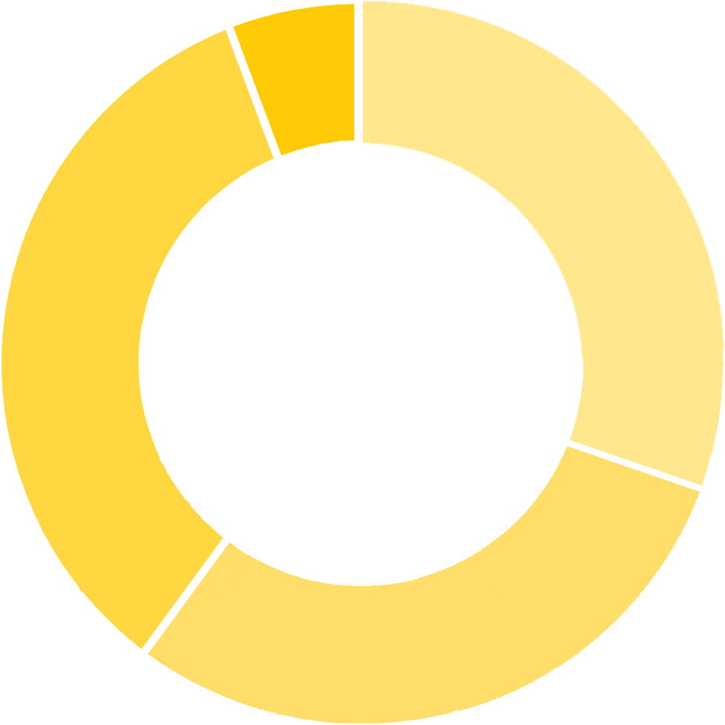
Projects By Cost
As of January 1, 2024
31% UNDER $50K
23% $50K to $200K
38% $200K to $4M
8% OVER $4M
8%
(59 PROJECTS)
284
Current
Projects
31%
38%
(43 PROJECTS)
(72 PROJECTS)
23%
Current Projects Only
does not include Completed Projects, or projects with budgets TBD
(14 PROJECTS)
University of Central Florida
Page 11

Slide 13
Notes:
Public Safety Building Computer Room HVAC Replacment
Exterior Storage Structure
telecom upgrades rosen
ADA doors partnership 5
Stadium drone detection system
Fire Alarm Replacement Nike Housing
Relocate Electromagnet Physical Sciences Bldg
Partnership 5 Renovation
COM AV System Upgrade
Soccer Practice Field Camera
Visual Arts HVAC System
MIRC Multimedia Upgrade
Stadium Gate Lighting
Engineering 1 Lab
12

Slide 15
PDC Upcoming Projects
Housing
Deferred Maintenance
Parking & Roadways
HVAC Replacements – Orange Hall, Flagler Hall, Hercules Apartment Building 108
Visual Arts Building Transformer Replacement
Parking Lots H2, H3 & H4, Lots B3, B4, B5, & B6 & C3
Knights Plaza MDP Replacement
Garage D Elevator
Roof Replacements – Orange Hall, Seminole Hall,
Greek Parking Aux Lot
Knights Plaza HVAC Renovation
Stadium Fire Alarm Replacement
Football Campus Lot
Fire Alarm Replacements –Hercules Apartments
Arena & Venue Building Envelope Repair
Football Campus Promenade
Exterior Metal Stairwell Replacements / Repairs – Orange Hall, Lake Claire Buildings 55 & 57
Communication and Media Building MDP Replacement
Other Project of Interest
Window Replacements / Exterior Painting – Lake Claire Buildings 56, 58, 69 & 60
Campus Wide Exterior Lighting Upgrades
Multiple Lab Renovations at Physical Sciences Buildings
Crawl Space Structural and MEP Repairs
Classroom Technology Upgrades across campus
Communication and Media Building Roof Replacement
Bear Deterrent Fence for Bee Farm
University of Central Florida
Page 14

Slide 16
Utilities & Engineering Services
Duane Siemen, Assistant Vice President

Slide 17
UES Team
Duane Siemen
Assistant Vice President
Utilities & Engineering Services
Ana Santiago
Administrative Coordinator
Alberto Santoni
Senior Director Facilities Engineering
Alex Parlato
Director Utilities Smart Infrastructure
Amanda Lindsay
Manager Stormwater Compliance
Dale Lance
Manager Utilities Production
Saul Santiago
Manager Utilities Production
Tracy Kelley Manager
BAS II
Keith Coelho
Manager Energy Management
Shannon Ashworth
Manager Geographic Info Systems
University of Central Florida
Page 16

Slide 18
UES Future Projects
Underground Infrastructure
Building Automation Controls
Repair/ Replacement:
Repair/Replacement:
Chilled water, Reclaim water,
Domestic Potable Water,
Stormwater
Processors, cabling, control valves, VAV’s, programming
Chillers and Cooling Towers
Commissioning
Replacement:
Repairs/Replacement/ Audits:
2000 T Chillers and fan array cooling towers
Retro commissioning, recommissioning and energy audits
University of Central Florida
Page 17
Notes:
1.7.2013
4
‹#›

Slide 19
Page 18

Slide 20
Facilities Operations
John McInerney, Director of Facilities Maintenance

Slide 21
Justin Wisor
Assistant Vice President
Facilities Operations
FO Team
Marklyne Joachim
Executive Assistant I
Travis Simmons
Dir, Landscape & Natural Resources
John McInerney
Dir, Facilities Maintenance
Alyssa Crews
Dir, Reliability &
Logistics Operations
Jaime Morales
Dir, Facilities Maintenance
Amy Childs
Dir, Facilities Ops Housing
Joe Finnigan
Dir, Facilities Management
Tom Snyder
Mgr, Facilities Maintenance I
Carlos Orozco
Mgs, Maintenance
Planning I
Chris Turnage
Mgr, Housekeeping I
Jason Soler
Custodial Program Mgr
Vivian Garzon
Production Mgr
Shawn Jamali
Sr. Mgr, Facilities Maintenance I
Lance Watkins
Mgr, Warehouse
Planning III
Tianna Campbell
Mgr, Facilites Maintenance I
Lisa Ramsey
Zone Mgr, Recycling Services
Derek Diener,
Mgr, Reliability &
Logistics
Randy Huckaba
Mgr, Facilities Maintenance I
Michael Cecere
Sr. Mgr, Facilities Maintenance
William Smith
Mgr, Asset Management
University of Central Florida
Page 20

Slide 22
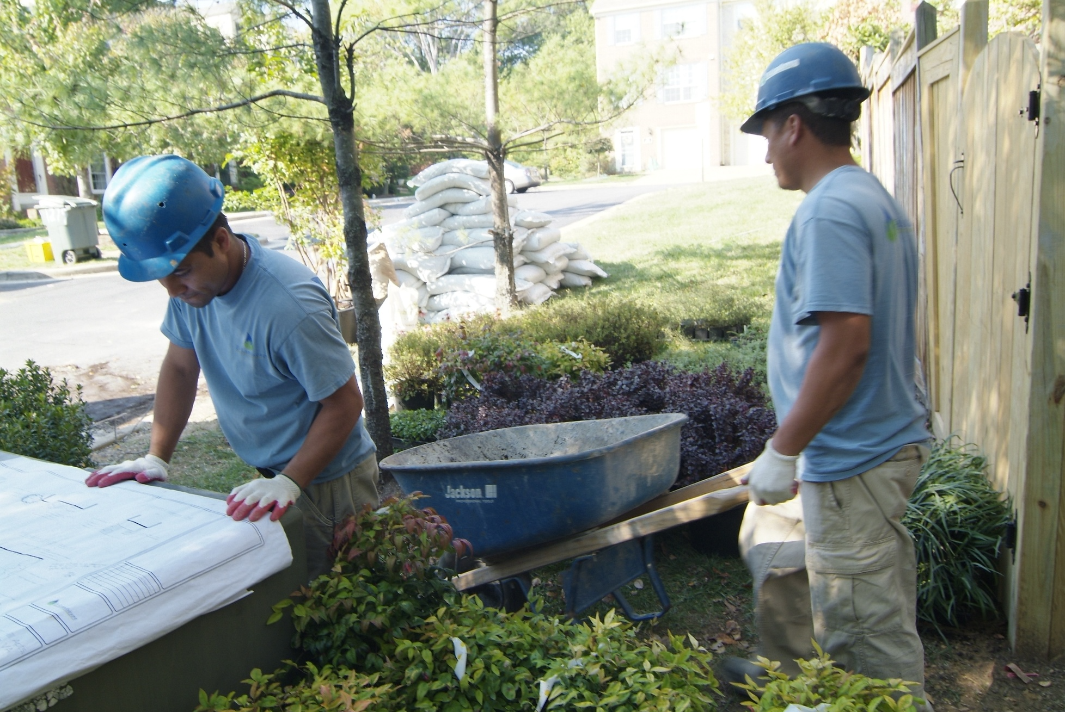
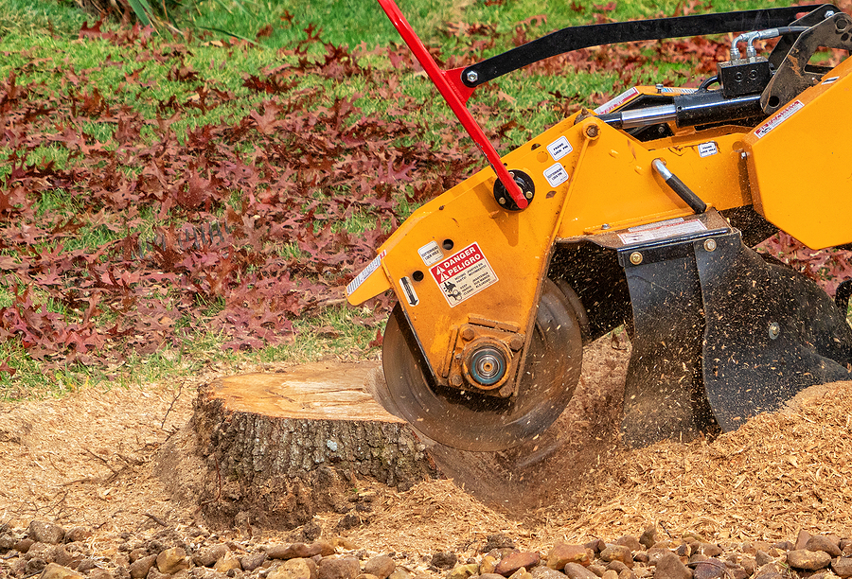
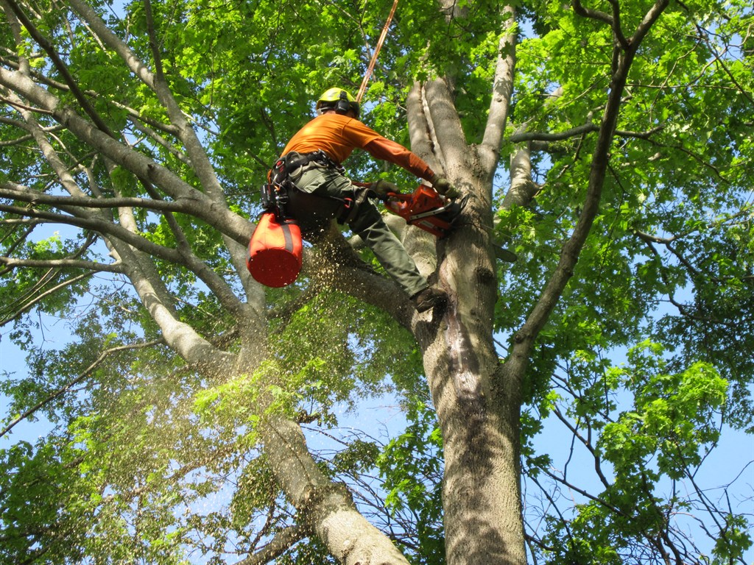
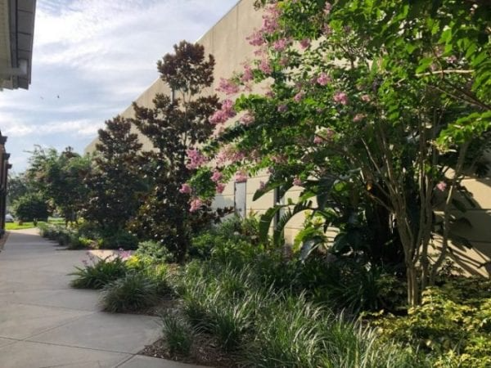
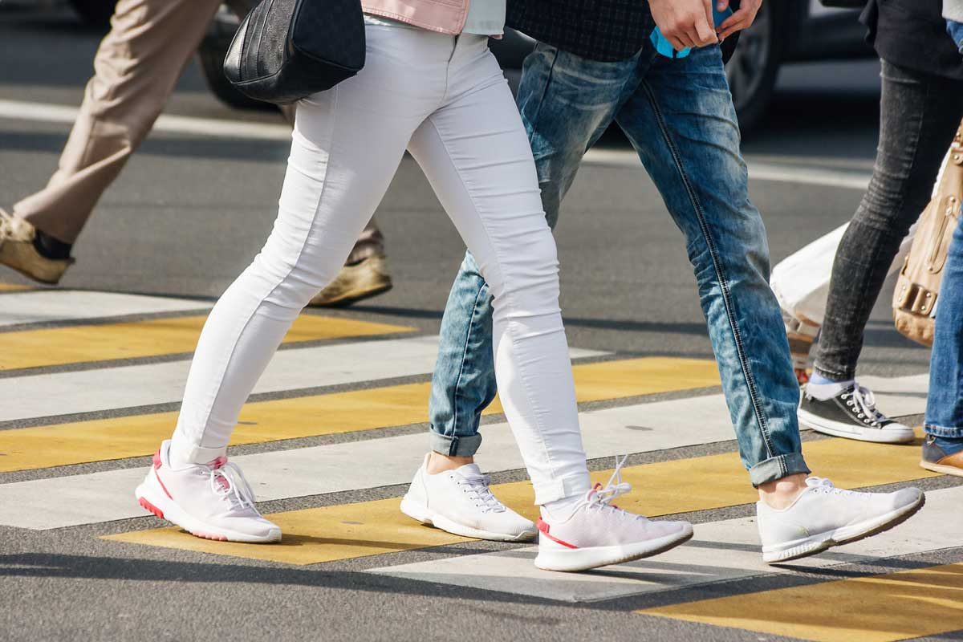
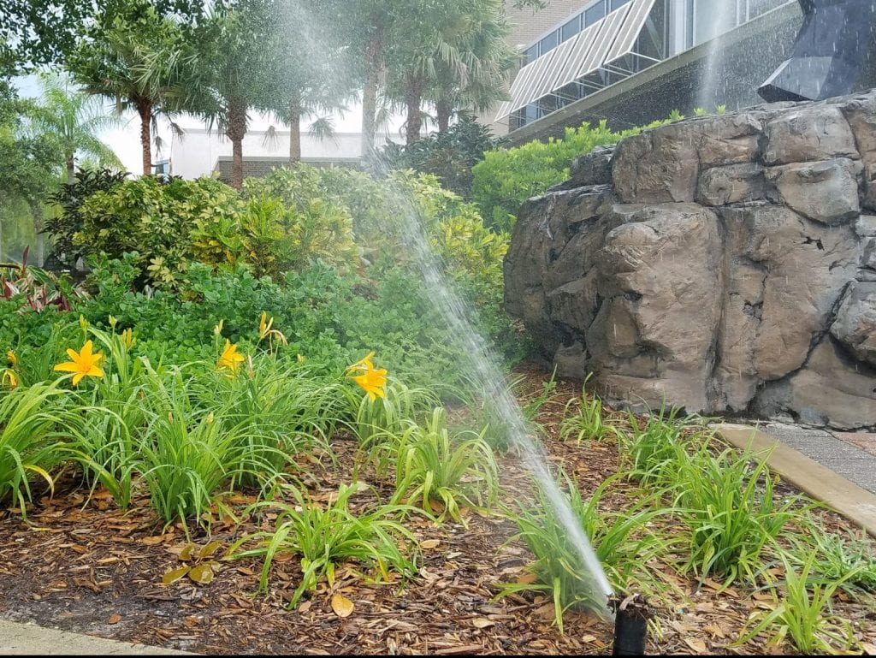
Landscape and Natural Resources
Contractor Work Needed
Landscape Install & Design
Stump Grinding
Tree Pruning & Removal
Hardscape
Sidewalk & paver repair
Irrigation Work
Proper landscape maintenance keeps facilities looking tidy and prevents damage.

Slide 23
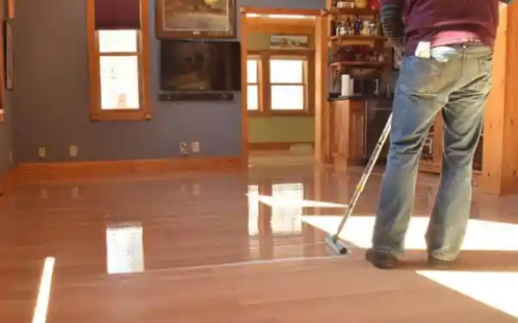
Housekeeping Contractor Work Needed
Floor Care
Building Care
Restroom Restoration (grout color, etc.)
Soft washing of exterior
Aliphatic Urethane application
Window Cleaning exterior, some interior
Implementation of color chips/seal
Interior High rafter cleaning
Carpet Care (might be a need at Satellite locations)
University of Central Florida
Page 22
Notes:
24

Slide 24
Facilities Operations Maintenance
Mechanical HVAC
Electrical
Plumbing
Fire Systems
Parking Services
Lock shop
PM Shops
General Trades
Life Safety Code Required
Auto Shop
General Maintenance, Paint, Roof, Sign, Elevator
Housing and Satellite Campuses
Lake Nona, Rosen, Downtown
University of Central Florida
Page 23
Notes:
1

Slide 25
Contractor Work Needed
HVAC
Plumbing
Auto Shop
Repair/ Replacement/Refurbishment:
Repair/Replacement:
Repair:
AHU, CU’s , FCU’s, RTU’s, Pumps & Motors, Liebert Units , Chillers ,Heat Exchangers, Boilers, Duct Heaters, VAV’s, Dampers, Control Air Compressors, Valve, Insulation, Duct Cleaning
Hot Water Tanks, Booster Pumps, Emergency Work- Major Pipe Repairs
Body Shop, Alignments, Complex Engine work, Generator repairs
Parking Services
General Trade Shops
Repairs/Replacement:
Repair/Replacement:
Pothole Repair, Paving, Striping
Roofs, Building Envelope, New Frame and Door Installations, Access Control Hardware, Automatic Electronic Door Operators, Bathroom Remodel/Rejuvenation, Large Flooring Replacements
Electrical
Repair/Replacement:
Lab Air Compressors, Emergency Work, Large Conductor/Underground, Direct Burial, Panel Replacements
Fire Systems
Repairs/Replacement:
Panels, Component, Sprinkler, Pre-Action, Specialty Systems
University of Central Florida
Page 24
Notes:
4

Slide 26
Fire Hydrant Replacement
Plumbing Leak Repairs
Plumbing Leak Repairs
Hot Water Pump Replacement
Door Replacement
Notes:
5

Slide 27
UCF: Refurbishment Before and After Shown
University of Central Florida
Page 26
Notes:
6

Slide 28
Pathways for Partnership with UCF
Samantha Mason, Construction Support Team Manager

Slide 29
Prequalified Vendor
Continuing Service Contract
Meet minimum requirements
General Contractor < $500K; July 2024
Roofing; Oct 2024
Structural Engineering; Nov 2024
Tree Care; Nov 2024
Register as UCF Supplier
Pathways for Partnership with UCF
Government & Cooperative Agreements
Public Competitive Solicitation
PDC website – current advertisements https://fp.ucf.edu/vendors/current-advertisements/
Provide existing contracts
Florida Administrative Weekly https://www.flrules.org/bigDoc/Default.asp
Notes:
22

Slide 30
Minimum Requirements | Minimum Requirements
 | State (FL) certified professional license in appropriate discipline for work that requires permitting.
 | Commercial Liability > $1M Automobile Liability > $1M Workers Comp at statutory Limits Employer’s Liability > $1M
 | Required by Florida Statute 255.05 on projects with a contract price > $100K, but may be waived for projects < $200K. Certified copy of the recorded bond must be provided prior to commencing work No payments will be received prior to receipt of the bond
Professional License
Insurance
Bond
University of Central Florida
Page 29
Notes:
23

Slide 31
Competition Requirements | Competition Requirements
< $ 25K | Request for Proposal(s) from prequalified contractors, including Continuing Service Contractors (CSC) (Competition is encouraged, but not required) Use of existing contracts (Piggyback)
< $ 75K | Request for Proposals from prequalified contractors, including CSC (Two informal proposals are required) Use of existing contracts (Piggyback)
< $ 150K | Request for Proposals or Invitation to Bid via e-Builder to prequalified contractors, including CSC (At least three formal proposals are required) Use of existing contracts (Piggyback)
$ 150K-$ 4M | Invitation to Bid via e-Builder to Continuing Service Contractors (At least three formal proposals are required) Public solicitation for Invitation to Bid Use of existing contracts (Piggyback)
> $ 4M | Public solicitation for Invitation to Bid / Negotiate
University of Central Florida
Page 30
Notes:
24

Slide 32
Questions?

Slide 33
Meet and Greet
Planning, Design & Construction Team
Utilities & Engineering Team
Facilities Operations Team

